Slide 1


Intro to
SEM
Enrico Perinelli
Introduction to Structural Equation Modeling
Enrico Perinelli
Department of Psychology and Cognitive Science
University of Trento
Lectures for the PhD course in Cognitive Science
Department of Psychology and Cognitive Science
University of Trento
January 11 / 12 / 18 / 19 / 26, 2024

Slide 2
Intro to
SEM
Enrico Perinelli
Who am I?
Academic
Research Fellow (RTD-a) July 1 2021 – ongoing
Work and Organizational Psychology (M-PSI/06)
Postdoctoral Researcher – University of Trento Sept 15, 2018 – June 30, 2021
Work and Organizational Psychology (M-PSI/06)
Education
Ph.D. – Sapienza University of Rome Feb 2018
Personality and Organizational Psychology
M.S. – University of Bologna Feb 2013
Clinical Psychology
B.S. – University of L’Aquila Oct 2010
Psychology

Slide 3
Intro to
SEM
Enrico Perinelli
Who am I?
Research Areas
Organizational Psychology, Personality Psychology, Psychometrics
Educational Psychology and Individual Differences
Research Topics
Social desirability scales
Individual differences in personality from childhood (moral disengagement, effortful control) to Adulthood (big five, positivity)
Methodological and theoretical issues in the study of self-esteem
Personality factors and organizational outcomes (e.g., Well-Being at work)
Methodological issues in organizational psychology and management
Non-cognitive skills in junior high school students

Slide 4
Intro to
SEM
Enrico Perinelli
Who am I?
Research Projects and Practical Applications
Guardia di Finanza (Sapienza University of Rome)
Mobbing (Autonomous Province of Trento and Univ of Trento)
Nudging and Unemployment (Autonomous Province of Trento and Univ of Trento)
Non-cognitive skills in Junior high school students (Fondazione Caritro and Univ of Trento)
Member of the WebeWo LAB -> Interdisciplinary lab (Law, Psychology, Sociology) that aims to study interventions, antecedents, and outcomes of well-being at work
PRIN PNRR 2022 – P.I. of the project «Loneliness, non-cognitive skills, and academic achievement in Junior High School: Assessment and intervention based on Big Data, longitudinal, and intensive methods»
More info at
https://webapps.unitn.it/du/it/Persona/PER0209265/Curriculum

Slide 5
Intro to
SEM
Enrico Perinelli
Who Are You?
….please, introduce your
name
background
skills
acquired knowledge
expectations about this course….. and the PhD in general
This is useful to start creating a collaborative, positive, and multidisciplinary organizational climate…

Slide 6
Intro to
SEM
Enrico Perinelli
Schedule
11 January 2024 – Aula 1
12 ‘‘ ‘‘ – ‘‘
18 ‘‘ ‘‘ – ‘‘
19 ‘‘ ‘‘ – ‘‘
26 ‘‘ ‘‘ – Aula 11 (Project Presentation)
Your project for this PhD course will involve one of the following options:
A theoretical or practical argument focusing on a Structural Equation Modeling (SEM) technique (e.g., mediation with SEM, Longitudinal SEM, Latent Growth Modeling, etc.)
The examination and discussion of one or more articles that report SEM findings.
Data analysis using Mplus or R. You have the flexibility to choose whether to analyze your own dataset, an open-access dataset, or a simulated dataset.
Hypothesize a SEM pipeline – from Model Formulation to Model Evaluation – accompanied by hypothetical codes (in R or Mplus)

Slide 7
Intro to
SEM
Enrico Perinelli
Let’s start our journey...

Slide 8
Intro to
SEM
Enrico Perinelli
The need for Latent Variable Models
Problems with Measurement
The focus of Psychology is the study of human behaviors and human cognitive processes. Thus, it is difficult to think at tools capable to assess them.

Slide 9
Intro to
SEM
Enrico Perinelli
The need for Latent Variable Models
Problems with Measurement
In 1940 a committee established by the British Association for the Advancement of Science concluded that measurements taken in psychological methods could not be considered “scientific measurements”.

Slide 10
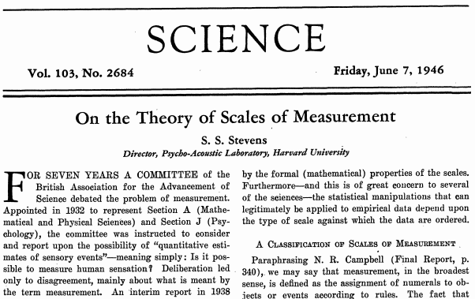
Intro to
SEM
Enrico Perinelli
The need for Latent Variable Models
Solutions for improving Measurement
Stevens (1946)
MEASUREMENT
is defined as the
assignment of numerals
to objects or events
according to rules

Slide 11
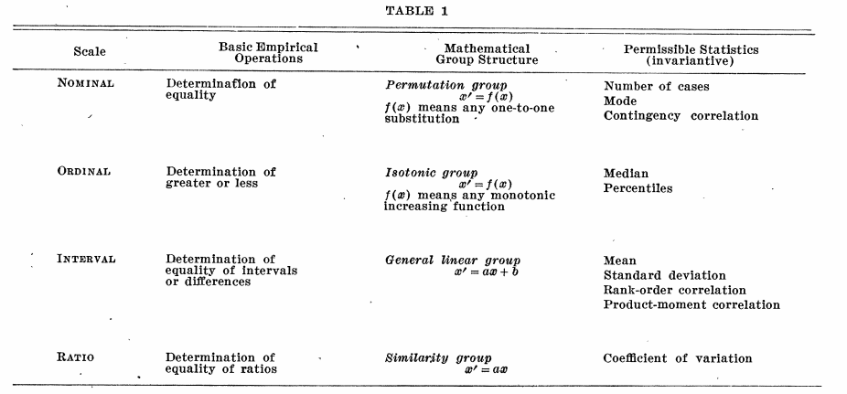
Intro to
SEM
Enrico Perinelli
The need for Latent Variable Models
Solutions for improving Measurement
Stevens (1946)
SCALES
Nominal
Ordinal
Interval
Ratio

Slide 12
Intro to
SEM
Enrico Perinelli
The need for Latent Variable Models
Solutions for improving Measurement
Self-report questionnaires, Other-report questionnaires, Objective measures, ecc.
Two pivotal concepts:
RELIABILITY → Precision of a measurement (X_{i} = T_{i} + E_{i})
VALIDITY → The instrument is a proper tool for measuring what it aims to measure.
An instrument may be reliable, but not valid (e.g., I cannot use a “reliable” ruler for measuring intelligence)

Slide 13
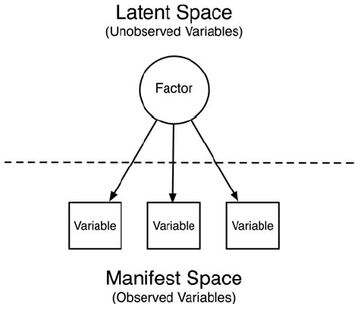
Intro to
SEM
Enrico Perinelli
The need for Latent Variable Models
Solutions for improving Measurement
The focus on statistical
methods has been pivotal for the
advancement of the concept of
measurement in Psychology
From Nesselroade & Molenaar (2016)

Slide 14
Intro to
SEM
Enrico Perinelli
The need for Latent Variable Models
Solutions for improving Measurement
Operationalization Process
Construct
Instrument
Indicators
Variables

Slide 15
Intro to
SEM
Enrico Perinelli
Operationalization Process:
An Example
Latent Space
(Unobservable Variables)
Conscientiousness
Conscientiousness
Big Five
Questionnaire
(only selected items
that refer to
conscientiousness)
“Scrupulousness” (orderliness and precision) and “Perseverance” (capability of fulfilling one’s own tasks and commitments)
ITEM_1 I tend to be very thoughtful
ITEM_2 Before completing a job I spend a lot of time revising it
ITEM_3 It’s difficult for me to give up an activity I’ve undertaken
ITEM_4 If I fail in a task, I keep trying until I succeed
ITEM_1
ITEM_2
ITEM_3
ITEM_4
Manifest Space
(Observed Variables)

Slide 16
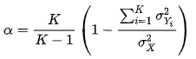
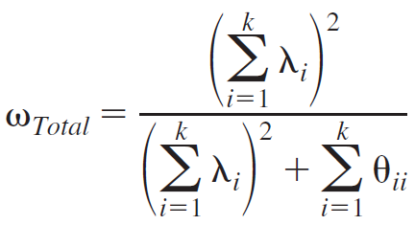
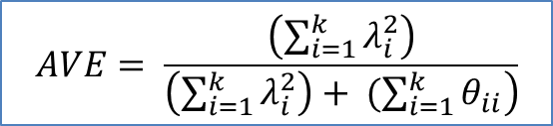
Intro to
SEM
Enrico Perinelli
The need for Latent Variable Models
Reliability: Consistency (precision) of a measure
- Reliability (General formula)
ρ_{xx} = [Var(T) / Var(T + E)], with values ranging from 0 to 1
- Cronbach’s Alpha
X = Y₁ + Y₂ + Y₃ + … + Y_{k}
K = number of components (e.g., items)
σ²_{Yi} = variance of the component i
σ²_{X} = variance of the observed total score
λ_{i} = factor loading of the component i;
a factor loading represents the strenght of the
relationship between an indicator and its latent
variable
θ_{ii} = Residual variance of the component i
- Omega total
$$AVE= \frac{\left(\sum_{i=1}^{k}{λ_{i}^{2}}\right)}{\left.\left(\sum_{i=1}^{k}{λ_{i}^{2}}\right)+ (\sum_{i=1}^{k}{θ_{ii}}\right)}$$
- AVE (Average Variance Extracted)
> .50

Slide 17

Intro to
SEM
Enrico Perinelli
The need for Latent Variable Models
Validity: A test is valid if it measures what it purports to measure” (Borsboom et al., 2004, p. 1061)
“The problem of validity cannot be solved by psychometric techniques or models alone. On the contrary, it must be addressed by substantive theory”
(Borsboom et al., 2004, p. 1062).

Slide 18
Intro to
SEM
Enrico Perinelli
The need for Latent Variable Models
Validity: “A test is valid if it measures what it purports to measure” (Borsboom et al., 2004, p. 1061)
Validity
Qualitative
Internal (or structural)
External
Evaluation of item content, comprehensiveness, and adeguacy
Face validity (non-experts[a potential test-taker])
Content validity (experts)
Internal structure of the measure (e.g., number of factors, reliability)
Relationship between a measure and other constructs or measures
Compared to
Construct validity
Criterion validity
Direction of effect
Covergent validity(+)
Divergent validity(-)
Discriminant validity(n.s.)

Slide 19
Intro to
SEM
Enrico Perinelli
The need for Latent Variable Models
Researcher’s main tasks in Personality Psychology
Measuring constructs
(Exploratory Factorial Analysis; EFA)
Connecting constructs
(Regression Models)

Slide 20
Intro to
SEM
Enrico Perinelli
The need for Latent Variable Models
Measuring Constructs
Construct 1
Construct 2
i₁
i₂
i₃
i₄
i₅
i₆
i₇
i₈
i₉

Slide 21
Intro to
SEM
Enrico Perinelli
The need for Latent Variable Models
Measuring Constructs (EFA)
ψ (true variances and covariance)
Construct 1
Construct 2
λ (factor loadings)
i₁
i₂
i₃
i₄
i₅
i₆
i₇
i₈
i₉

Slide 22
Intro to
SEM
Enrico Perinelli
Seeking Resources
1. I ask other feedback on my performance
2. I ask colleagues for advice [I ask other educational superintendents for advice]
3. I ask my supervisor for advice [I ask other managers for advice (not educational superintendents]
4. I try to learn new things at work
5. I contacted other people from work (e.g., colleagues, supervisors) to get the necessary information for completing my tasks
6. When I have difficulties or problems at my work, I discuss them with people from my work environment
Seeking Challenges
7. I ask for more tasks if I finish my work [I look for other projects to carry out, as soon as I conclude those planned]
8. I ask for more responsibilities
9. I ask for more odd jobs [I try to engage in projects/assignments that test myself]
The Likert scale ranged from 1 = never to 5 = often.
Hypothesized Construct | Item | 1 | 2
Seeking Resources (α = .71) | 1 | .34*** | .19***
 | 2 | .59*** | -.10***
 | 3 | .53*** | .18***
 | 4 | .46*** | .13***
 | 5 | .38*** | -.09***
 | 6 | .76*** | -.06**
Seeking Challenges (α = .83) | 7 | -.05* | .61***
 | 8 | .09** | .79***
 | 9 | .02^{n.s.} | .82***
Recommended thresholds:
|Target λ| > .30
|Non-target λ| < .30
N = 1060 superintendents
Latent Correlation = .40***

Slide 23
Intro to
SEM
Enrico Perinelli
The need for Latent Variable Models
Measuring Constructs (EFA)
ψ (true variances and covariance)
Construct 1
Construct 2
λ (factor loadings)
Main Limitation
Limited covariance(s) among contructs
i₁
i₂
i₃
i₄
i₅
i₆
i₇
i₈
i₉

Slide 24
Intro to
SEM
Enrico Perinelli
The need for Latent Variable Models
Connecting Constructs (Regression)
Y_{i} = β₀ + β₁X_{1i} + β₂X_{2i} + β₃X_{3i} + ε_{i}
X₁
ε
β₁
X₂
β₂
Y
β₃
X₃

Slide 25
Intro to
SEM
Enrico Perinelli
The need for Latent Variable Models
Connecting Constructs (Regression)
Y_{i} = β₀ + β₁X_{1i} + β₂X_{2i} + β₃X_{3i} + ε_{i}
X₁
ε
β₁
X₂
β₂
Y
Main Limitations
Don’t take into account measurement error
One Dependent Variable
β₃
X₃

Slide 26
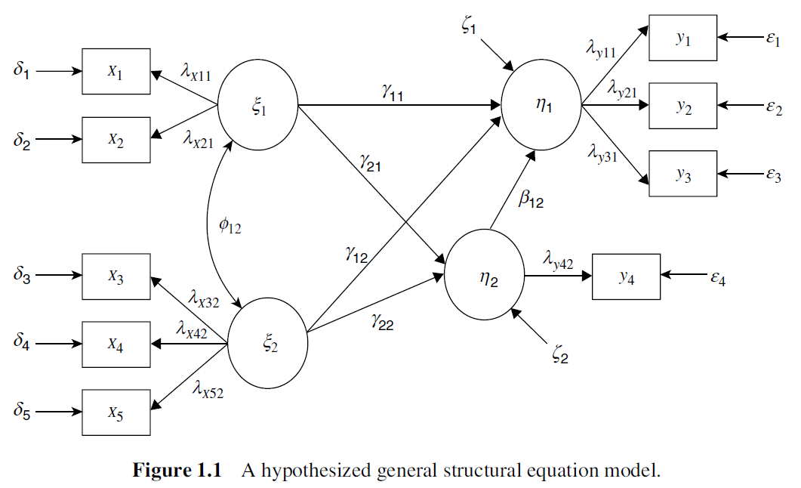
Intro to
SEM
Enrico Perinelli
Structural Equation Modeling (SEM)
(Wang & Wang, 2012)

Slide 27
Intro to
SEM
Enrico Perinelli
History of SEM
SEM (also called covariance structure analysis, covariance structure modeling, or analysis of covariance structures) does not designate a single statistical technique but instead refers to a family of related procedures (Kline, 2016, p. 9).
In SEM, unobservable latent variables (constructs or factors) are estimated from
observed indicator variables, and the focus is on estimation of the relations among
the latent variables free of the influence of measurement errors.
Measurement (Factor Analysis)
(Spearman, 1904; Tucker, 1955)
Simultaneous Equations (Path Analysis)
(Wright, 1918, 1921, 1934)
SEM
(Jöreskog, 1967, 1969, 1973; Keesling, 1972; Wiley, 1973)
Matsueda, R. L. (2012). Key advances in the history of Structural Equation Modeling. In R. H. Hoyle (Eds.), Handbook of Structural Equation Modeling (pp. 17-42). New York, NY: Guilford
JKW Model

Slide 28
Intro to
SEM
Enrico Perinelli
History of SEM
Matsueda (2012) argued that we can track 4 stages across SEM history, each of which characterized by a strong reliance on insights from statistics
early disciplinary-specific developments of path analysis first from genetics and later sociology, factor analysis from psychology, and simultaneous equation models in economics;
cross-disciplinary fertilization between economics, sociology, and psychology, leading to an explosion of empirical applications of SEM;
a period of developing methods for handling discrete, ordinal, and limited dependent variables;
a recent period of incorporating statistical advances into the SEM framework, including generalized linear models, mixed effects models, mixture regression models, Bayesian methods, graphical models, and methods for identifying causal effects.
We are now approaching a fifth stage (e.g., Jacobucci & Grimm, 2020):
(5) Latent variables ↔ data science, artificial intelligence (machine learning)
Jacobucci, R., & Grimm, K. J. (2020). Machine learning and psychological research: The unexplored effect of measurement. Perspectives on Psychological Science, 15(3), 809-816. https://doi.org/10.1177/1745691620902467
Matsueda, R. L. (2012). Key advances in the history of Structural Equation Modeling. In R. H. Hoyle (Eds.), Handbook of Structural Equation Modeling (pp. 17-42). Guilford

Slide 29

Intro to
SEM
Enrico Perinelli
SEM and Psychometrics
The study of quantitative measurement in psychology
Assessment
Data Analytic Strategy
Simulation
General Linear Models, Factor Analysis, Structural Equation Modeling, Cluster analysis
Monte Carlo Methods, Performance of estimators, Optimal sample size
INSTRUMENTS
DESIGNS
Self-reports, Other-reports, Objective measures
Cross-sectional, Longitudinal, Hierarchical

Slide 30
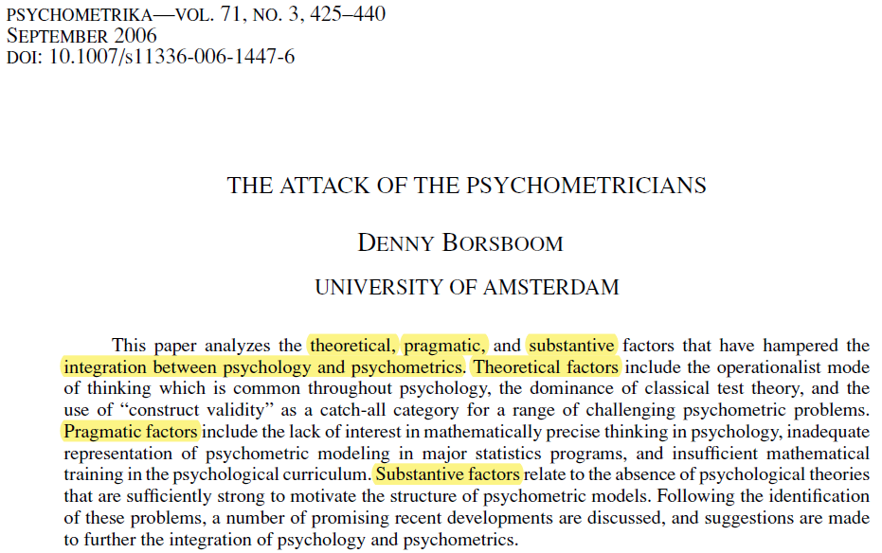
Intro to
SEM
Enrico Perinelli
THEORY
METHODS
“The founding fathers of the Psychometric Society—scholars such as Thurstone, Thorndike, Guilford, and Kelley—were substantive psychologists as much as they were psychometricians.
Contemporary psychometricians do not always display a comparable interest with respect to the substantive field that lends them their credibility.
It is perhaps worthwhile to emphasize that, even though psychometrics has benefited greatly from the input of mathematicians, psychometrics is not a pure mathematical discipline but an applied one. If one strips the application from an applied science one is not left with very much that is interesting; and psychometrics without the “psycho” is not, in my view, an overly exciting discipline. It is therefore essential that a psychometrician keeps up to date with the developments in one or more subdisciplines of psychology.” (Borsboom, 2006, p. 436)

Slide 31
Intro to
SEM
Enrico Perinelli
Structural Equation Modeling
Steps
Model formulation Specifying the SEM model that the researcher wants to test. The model may be formulated on the basis of theory or empirical findings. A general SEM model is composed of two parts: the measurement model and the structural model.
Model identification It determines whether there is a unique solution for all the free parameters in the specified model.
Model estimation Estimate model parameters and generate fitting function. Various estimation methods are available for SEM (e.g., ML, WLS, Bayes, ecc.).
Model evaluation Assess whether the model fits the data.
Model modification If the model does not fit the data, re-specification or modification of the model is needed. In this instance, the researcher makes a decision regarding how to delete, add, or modify parameters in the model.
(Wang & Wang, 2012, p. 2)

Slide 32
Intro to
SEM
Enrico Perinelli
Model Formulation
Steps
Model formulation Specifying the SEM model that the researcher wants to test. The model may be formulated on the basis of theory or empirical findings. A general SEM model is composed of two parts: the measurement model and the structural model.
Model identification It determines whether there is a unique solution for all the free parameters in the specified model.
Model estimation Estimate model parameters and generate fitting function. Various estimation methods are available for SEM (e.g., ML, WLS, Bayes, ecc.).
Model evaluation Assess whether the model fits the data.
Model modification If the model does not fit the data, re-specification or modification of the model is needed. In this instance, the researcher makes a decision regarding how to delete, add, or modify parameters in the model.
(Wang & Wang, 2012, p. 2)

Slide 33
Intro to
SEM
Enrico Perinelli
Model Formulation
(Wang & Wang, 2012)

Slide 34
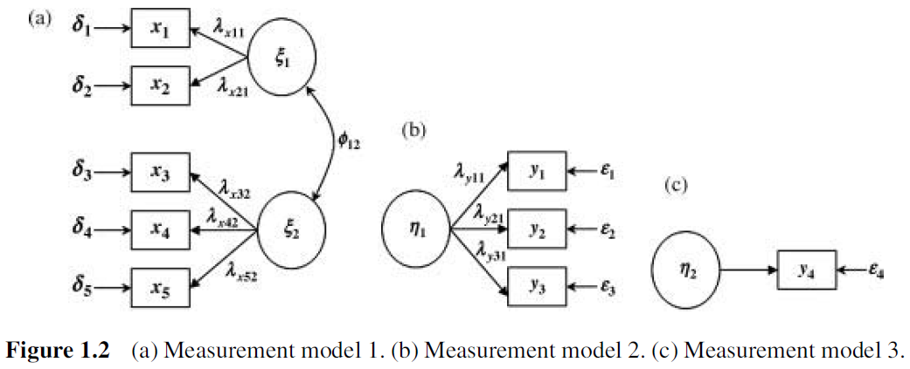
Intro to
SEM
Enrico Perinelli
Model Formulation
Measurement Models
(Wang & Wang, 2012)

Slide 35
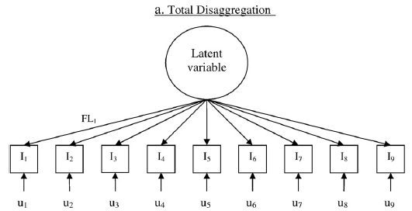
Intro to
SEM
Enrico Perinelli
Model Formulation
Types of Measurement Models
Single items
(Williams & O’Boyle, 2008, p. 234)

Slide 36
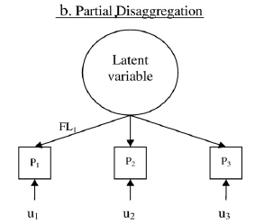
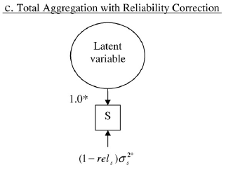
Intro to
SEM
Enrico Perinelli
Model Formulation
Types of Measurement Models
Parcel approach
Domain representative approach
Composite score
(Williams & O’Boyle, 2008, p. 234)

Slide 37
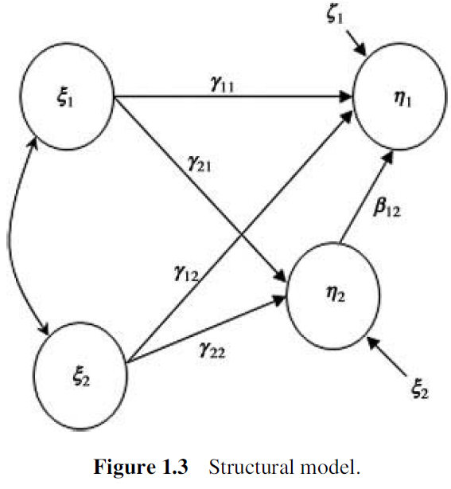
Intro to
SEM
Enrico Perinelli
Model Formulation
Structural Model
The term "structural" stands for the assumption that the parameters are
not just descriptive measures of association but rather that they reveal an invariant "causal" relation.
(Bollen, 1989, p. 4)
(Wang & Wang, 2012)

Slide 38
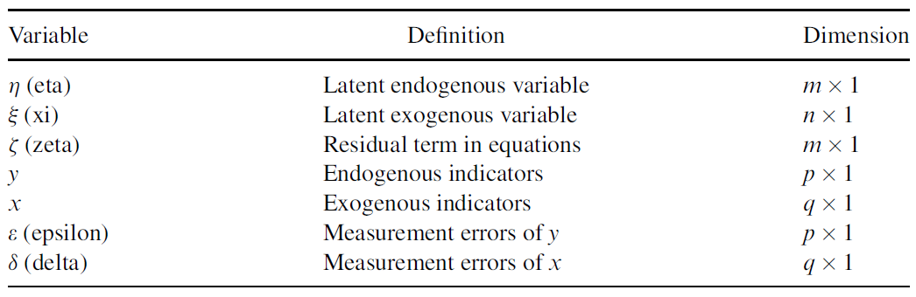
Intro to
SEM
Enrico Perinelli
Model Formulation
Variables
exogenous = independent
endogenous = dependent (but can also be predictors!!)
n = latent exogenous variables (ξ)
m = latent endogenous variables (η)
q = exogenous indicators (x)
p = endogenous indicators (y)
(Wang & Wang, 2012)

Slide 39
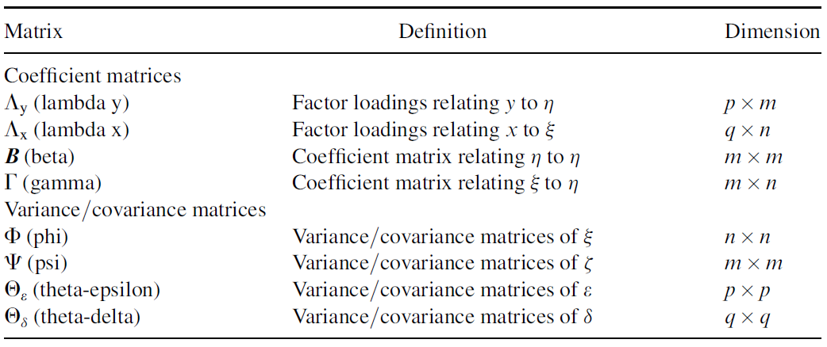
Intro to
SEM
Enrico Perinelli
Model Formulation
Matrices
(Wang & Wang, 2012)

Slide 40
Intro to
SEM
Enrico Perinelli
Model Formulation
Equations
Structural Model η = Βη + Γξ + ζ
Measurement Models Y = Λ_{y}η + ε
X = Λ_{x}ξ + δ
(Wang & Wang, 2012)

Slide 41
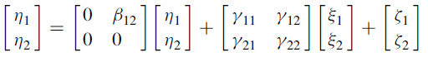
Intro to
SEM
Enrico Perinelli
Model Formulation
Equations
Structural Model η = Βη + Γξ + ζ
Measurement Models Y = Λ_{y}η + ε
X = Λ_{x}ξ + δ
η_{1i} = β₁₂ η_{2i} + γ₁₁ ξ_{1i} + γ₁₂ ξ_{2i} + ζ_{1i}
η_{2i} = γ₂₁ ξ_{1i} + γ₂₂ ξ_{2i} + ζ_{2i}
(Wang & Wang, 2012)

Slide 42
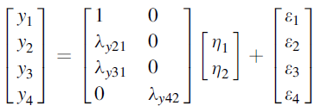
Intro to
SEM
Enrico Perinelli
Model Formulation
Equations
Structural Model η = Βη + Γξ + ζ
Measurement Models Y = Λ_{y}η + ε
X = Λ_{x}ξ + δ
y_{1i} = η_{1i} + ε_{1i}
y_{2i} = λ_{y21} η_{1i} + ε_{2i}
y_{3i} = λ_{y31} η_{1i} + ε_{3i}
y_{4i} = λ_{y42} η_{2i} + ε_{4i}
(Wang & Wang, 2012)

Slide 43
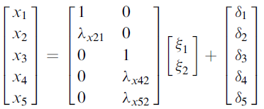
Intro to
SEM
Enrico Perinelli
Model Formulation
Equations
Structural Model η = Βη + Γξ + ζ
Measurement Models Y = Λ_{y}η + ε
X = Λ_{x}ξ + δ
x_{1i} = ξ_{1i} + δ_{1i}
x_{2i} = λ_{x21} ξ_{1i} + δ_{2i}
x_{3i} = ξ_{1i} + δ_{3i}
x_{4i} = λ_{x42} ξ_{2i} + δ_{4i}
x_{5i} = λ_{y52} ξ_{2i} + δ_{5i}
(Wang & Wang, 2012)

Slide 44
Intro to
SEM
Enrico Perinelli
Model Formulation
θ₁₁
θ₂₂
Muthén’s Model
ε₁
ε₂
y₁
y₂
λ₁₁
λ₂₁
η₁
ψ₃₃
ψ₄₄
β₃₁
ζ₃
ζ₄
ψ₁₁
ψ₁₂
η₃
η₄
ψ₂₂
β₄₃
η₂
β₃₂
λ₅₃
λ₆₃
λ₇₄
λ₈₄
λ₃₂
λ₄₂
y₅
y₆
y₇
y₈
y₃
ε₅
ε₆
ε₇
ε₈
y₄
ε₃
ε₄
θ₅₅
θ₆₆
θ₇₇
θ₈₈
θ₃₃
θ₄₄

Slide 45
Intro to
SEM
Enrico Perinelli
Model Formulation
Muthén’s Model
Structural Model η = Βη + Γξ + ζ
Measurement Models Y = Λ_{y}η + ε
X = Λ_{x}ξ + δ
Structural Model η = Βη + ζ
Measurement Model Y = Λη + ε
By adding intercepts/means
Structural Model η = ν + Βη + ζ
Measurement Models Y = α + Λη + ε

Slide 46
Intro to
SEM
Enrico Perinelli
Model Formulation
Exercise
Draw a SEM or find it in a publication
Specify which are the measurement models
Specify the “type/s” of measurement model (i.e., total disaggregation, partial disaggregation, total aggregation with reliability correction)
Specify what is the structural model

Slide 47
Intro to
SEM
Enrico Perinelli
Model Identification
Steps
Model formulation Specifying the SEM model that the researcher wants to test. The model may be formulated on the basis of theory or empirical findings. A general SEM model is composed of two parts: the measurement model and the structural model.
Model identification It determines whether there is a unique solution for all the free parameters in the specified model.
Model estimation Estimate model parameters and generate fitting function. Various estimation methods are available for SEM (e.g., ML, WLS, Bayes, ecc.).
Model evaluation Assess whether the model fits the data.
Model modification If the model does not fit the data, re-specification or modification of the model is needed. In this instance, the researcher makes a decision regarding how to delete, add, or modify parameters in the model.
(Wang & Wang, 2012, p. 2)

Slide 48
Intro to
SEM
Enrico Perinelli
Model Identification
Parameters
Model identification concerns whether a unique value for each and every unknown parameter can be estimated from the observed data (Wang & Wang, 2012, p. 11).
Parameters can be:
FIXED: forced to assume a specific value, such as 0 or 1
CONSTRAINED: to be equal to another parameter
FREE: estimated by the model

Slide 49
Intro to
SEM
Enrico Perinelli
Model Identification
Degrees of Freedom
df = [p(p + 1)]/2 – NFP > 0
p = number of observed variables, NFP = Number of free parameters
 | 1. | 2. | 3. | 4. | 5. | 6. | 7. | 8.
1. y₁ | Var(y₁)
2. y₂ | Cov(y₁ y₂) | Var(y₂)
3. y₃ | Cov(y₁ y₃) | Cov(y₂ y₃) | Var(y₃)
4. y₄ | Cov(y₁ y₄) | Cov(y₂ y₄) | Cov(y₃ y₄) | Var(y₄)
5. y₅ | Cov(y₁ y₅) | Cov(y₂ y₅) | Cov(y₃ y₅) | Cov(y₄ y₅) | Var(y₅)
6. y₆ | Cov(y₁ y₆) | Cov(y₂ y₆) | Cov(y₃ y₆) | Cov(y₄ y₆) | Cov(y₅ y₆) | Var(y₆)
7. y₇ | Cov(y₁ y₇) | Cov(y₂ y₇) | Cov(y₃ y₇) | Cov(y₄ y₇) | Cov(y₅ y₇) | Cov(y₆ y₇) | Var(y₇)
8. y₈ | Cov(y₁ y₈) | Cov(y₂ y₈) | Cov(y₃ y₈) | Cov(y₄ y₈) | Cov(y₅ y₈) | Cov(y₆ y₈) | Cov(y₇ y₈) | Var(y₈)
e.g. with 8 observed variables (p) we have (8*9)/2 = 36 non-redundant elements. Thus, NFP could be up to 35.

Slide 50
Intro to
SEM
Enrico Perinelli
Model Identification
Other assumptions
There are a number of other assumptioms for ensuring identification (see Bollen, 1989), but the most important is that the model must be recursive.
An example of nonrecursive model is a model with loops (Rigdon, 1995):
η₁
η₂

Slide 51
Intro to
SEM
Enrico Perinelli
Model Identification
Exercise
On your previous SEM (or another one)
Compute the maximum number of possible free parameters
Identify some fixed and free parameters (and constrained, if there are)

Slide 52
Intro to
SEM
Enrico Perinelli
Model Estimation
Steps
Model formulation Specifying the SEM model that the researcher wants to test. The model may be formulated on the basis of theory or empirical findings. A general SEM model is composed of two parts: the measurement model and the structural model.
Model identification It determines whether there is a unique solution for all the free parameters in the specified model.
Model estimation Estimate model parameters and generate fitting function. Various estimation methods are available for SEM (e.g., ML, WLS, Bayes, ecc.).
Model evaluation Assess whether the model fits the data.
Model modification If the model does not fit the data, re-specification or modification of the model is needed. In this instance, the researcher makes a decision regarding how to delete, add, or modify parameters in the model.
(Wang & Wang, 2012, p. 2)

Slide 53
Intro to
SEM
Enrico Perinelli
Model Estimation
Estimation of SEM models is different from that of multiple regressions.
Instead of minimizing the discrepancies between the fitted and observed values of the response variable [i.e., Σ(y - ŷ)], SEM estimation procedures minimize the residuals that are differences between the sample variances/covariances and
the variances/covariances estimated from the model. (Wang & Wang, 2012, p. 14).
Σ = Σ(θ)
Given that the population variances/covariances matrix (Σ) is unkown, it is replaced by the sample variances/covariances matrix (S), so that the null hypothesis is
S = Σ(θ)

Slide 54

Intro to
SEM
Enrico Perinelli
Model Estimation
There are several estimators, but the most common procedure is the use of Maximum Likelihood function
(Bollen, 1989, p. 107)
(N – 1)F_{ML} is chi-squared distributed with df = {[p(p + 1)]/2 – NFP}, where N is the sample size and F_{ML} is the value of the fitting function evaluated at the final estimates (Bollen, 1989, p. 110).
Recall that the null hypothesis of this chi-square test is H₀: S = Σ(θ).
Thus, a good model should show a non-significant chi-square test, because we expect non-significant differeces between S and Σ(θ)

Slide 55
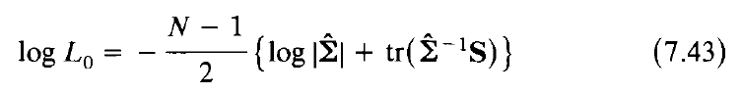
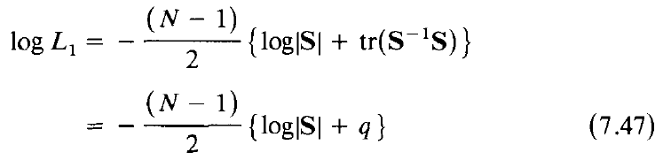
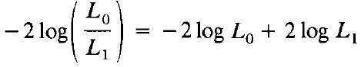
Intro to
SEM
Enrico Perinelli
Model Estimation
Bollen (1989, p. 263-265)

Slide 56
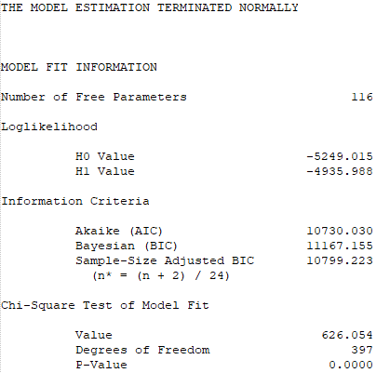
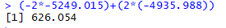
Intro to
SEM
Enrico Perinelli
Model Estimation
Example from an Mplus Output
Log-Likelihood for my specified model (log L₀)
Log-Likelihood for the saturated model (log L₁), namely for the model in which S = Σ(θ)
Model from Perinelli, Alessandri, Cepale, & Fraccaroli (2022)

Slide 57
Intro to
SEM
Enrico Perinelli
Model Estimation
Exercise
Compute both chi-square statistics and degrees of freedom using the following information. Pay attention! Add the vector of means (for simplicity, again p) to the computation of degrees of freedom, that is { {[p*(p + 1)]/2} + p } – NFP
Number of observed variables 9
Number of Free Parameters 41
Loglikelihood
H0 Value -1406.522
H1 Value -1397.180
Source: Model 3 from Avanzi, Perinelli et al. (2021, Anxiety, Stress, & Coping)

Slide 58
Intro to
SEM
Enrico Perinelli
Model Estimation
Exercise
Compute both chi-square statistics and degrees of freedom using the following information. Pay attention! Add the vector of means (for simplicity, again p) to the computation of degrees of freedom, that is { {[p*(p + 1)]/2} + p } – NFP
Number of observed variables 9
Number of Free Parameters 41
Loglikelihood
H0 Value -1406.522
H1 Value -1397.180
Solution
Chi-square = (-2*-1406.522)+(2*-1397.180) = 18.684
df = (((9*10)/2)+9)-41 = 13
Source: Model 3 from Avanzi, Perinelli et al. (2021, Anxiety, Stress, & Coping)

Slide 59
Intro to
SEM
Enrico Perinelli
Model Evaluation
Steps
Model formulation Specifying the SEM model that the researcher wants to test. The model may be formulated on the basis of theory or empirical findings. A general SEM model is composed of two parts: the measurement model and the structural model.
Model identification It determines whether there is a unique solution for all the free parameters in the specified model.
Model estimation Estimate model parameters and generate fitting function. Various estimation methods are available for SEM (e.g., ML, WLS, Bayes, ecc.).
Model evaluation Assess whether the model fits the data.
Model modification If the model does not fit the data, re-specification or modification of the model is needed. In this instance, the researcher makes a decision regarding how to delete, add, or modify parameters in the model.
(Wang & Wang, 2012, p. 2)

Slide 60
Intro to
SEM
Enrico Perinelli
Model Evaluation
χ² test is highly sensitive to sample size and to the number of variables included in the model.
“As such, the significance of the χ² test should not be a reason by itself to reject a model” (Wang & Wang, 2012, p. 18).

Slide 61
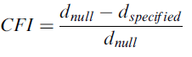
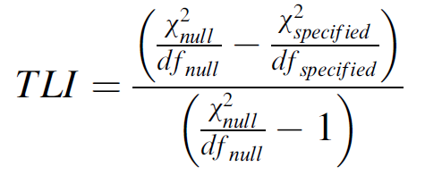
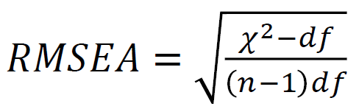
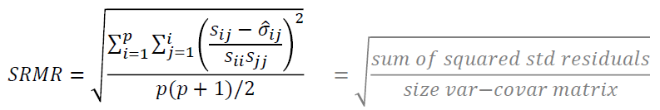
Intro to
SEM
Enrico Perinelli
Model Evaluation
Other Common Indices of Fit
d = noncentrality parameter = χ² – df
null = the worst model (all cov. are zero)
> .90-.95
> .90-.95
< .08 - .05
< .08 - .05

Slide 62
Intro to
SEM
Enrico Perinelli
Model Evaluation
Nested models
Definition:
Models “are nested [when] one model is produced by changing the status of one or more parameters in the other” (Hoyle, 2012, p. 11).
“Nested models are those for which the parameter space associated with one model is a subset of the parameter space associated with the other model” (Merkle, You, & Preacher, 2016, p. 152-153)
“Two models are nested if they are of the same form, but the free parameters of one model are a subset of the free parameters of the other model” (Hoyle, 2012, p. 141)
Nested models can be compared by means of Δχ² statistics, distributed with Δdf.
The resulting p-value will attest
whether removing 1 or more parameters significantly worsen (or not) the fit of the model
whether adding 1 or more parameters significantly improve the fit of the model

Slide 63
Intro to
SEM
Enrico Perinelli
Model Evaluation
Nested models
η₁
β₃₁
η₃
η₄
β₄₃
η₂
β₃₂
η₁
Δdf = 1
β₃₁
η₃
η₄
β₄₃
η₂
β₃₂

Slide 64
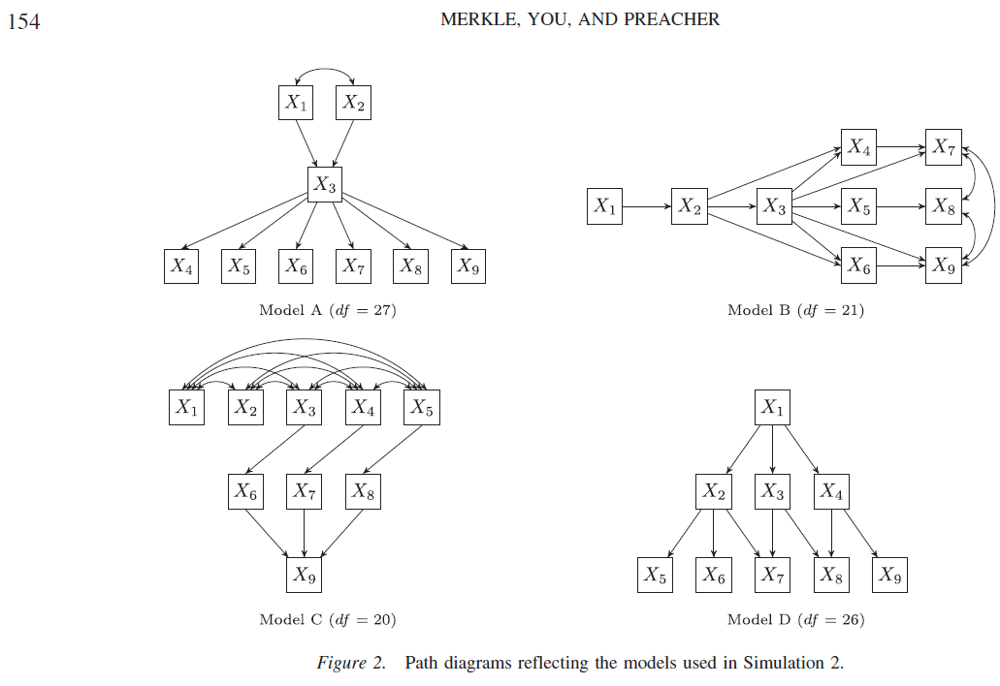
Intro to
SEM
Enrico Perinelli
Model Evaluation
Non-Nested models

Slide 65
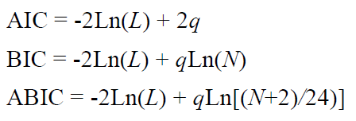
Intro to
SEM
Enrico Perinelli
Model Evaluation
Information Criteria Indices
Useful for comparing non-nested model
Ln(L) = log-likelihood value
q = number of free parameters
N = sample size
The model with the smaller values in these indices is preferred.
IMPORTANT: YOU CANNOT USE THESE INDICES WHEN THE log L₁ IS DIFFERENT ACROSS MODELS

Slide 66
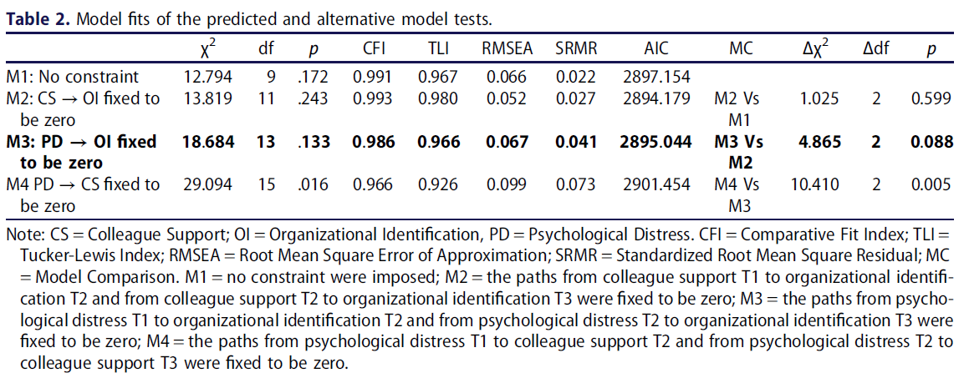
Intro to
SEM
Enrico Perinelli
Model Evaluation
Exercise: Fit and Nested Model Comparison
Avanzi, Perinelli et al. (2021)

Slide 67
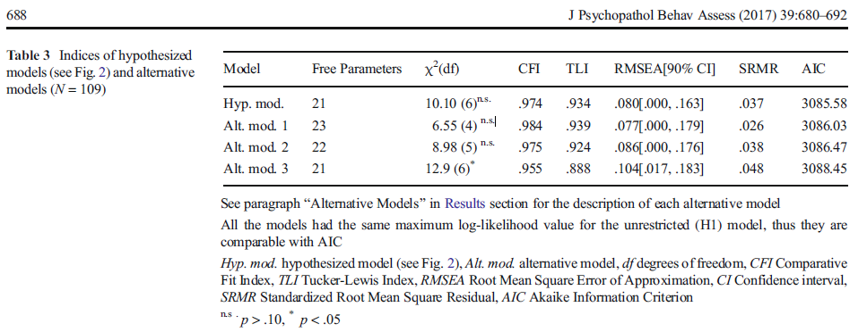
Intro to
SEM
Enrico Perinelli
Model Evaluation
Exercise: Fit and Non-Nested Model Comparison
Caprara, Gerbino, Perinelli et al. (2017)

Slide 68
Intro to
SEM
Enrico Perinelli
Model Modification
Steps
Model formulation Specifying the SEM model that the researcher wants to test. The model may be formulated on the basis of theory or empirical findings. A general SEM model is composed of two parts: the measurement model and the structural model.
Model identification It determines whether there is a unique solution for all the free parameters in the specified model.
Model estimation Estimate model parameters and generate fitting function. Various estimation methods are available for SEM (e.g., ML, WLS, Bayes, ecc.).
Model evaluation Assess whether the model fits the data.
Model modification If the model does not fit the data, re-specification or modification of the model is needed. In this instance, the researcher makes a decision regarding how to delete, add, or modify parameters in the model.
(Wang & Wang, 2012, p. 2)

Slide 69
Intro to
SEM
Enrico Perinelli
Model Modification
“If the model does not fit the data, re-specification or modification of the model is needed. In this instance, the researcher makes a decision regarding how to delete, add, or modify parameters in the model” (Wang & Wang, 2012, p. 2).
Modification Indices (MI): Change in χ² (i.e., Δχ²) after freeing a parameter
Usually, MI are provided in the output.
Use MI with caution: They must be justified from a theoretical and methodological point of view

Slide 70
Intro to
SEM
Enrico Perinelli
Structural Equation Modeling
Some Types and Applications

Slide 71
Intro to
SEM
Enrico Perinelli
Confirmatory Factor Analysis (CFA)
Work-Related Bullying
Personal Bullying
Social Isolation
Item 1
Item 6
Item 8
Item 2
Item 4
Item 5
Item 3
Item 7
Item 9

Slide 72
Intro to
SEM
Enrico Perinelli
Higher-order (or Second-order) CFA
Mobbing
Work-Related Bullying
Personal Bullying
Social Isolation
Item 1
Item 6
Item 8
Item 2
Item 4
Item 5
Item 3
Item 7
Item 9

Slide 73
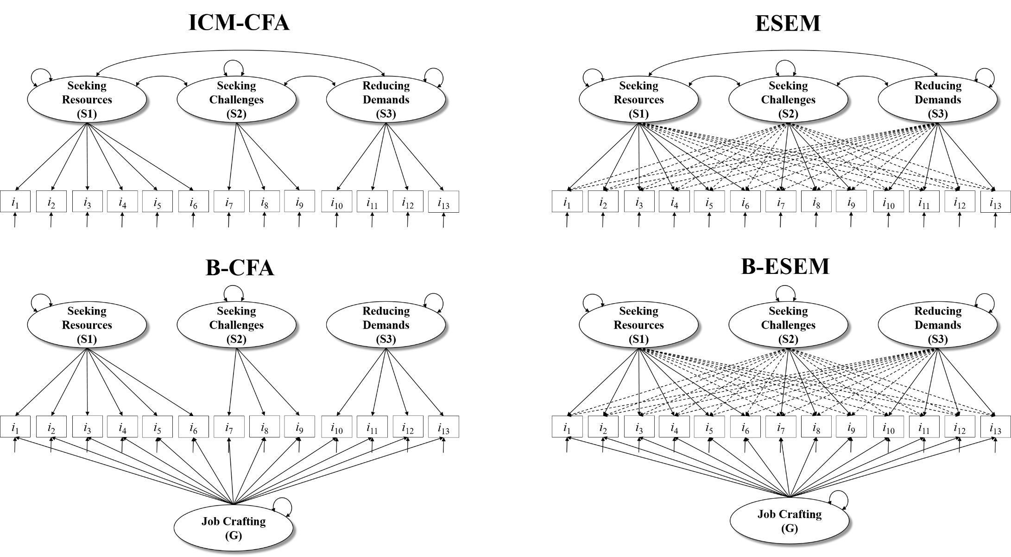
Intro to
SEM
Enrico Perinelli
Multidimensional Structure
Figure from Vignoli, Perinelli, Demerouti, & Truxillo (2023, Work, Aging and Retirement)
Morin, A. J., Myers, N. D., & Lee, S. (2020). Modern factor analytic techniques: Bifactor models, Exploratory Structural Equation Modeling (ESEM), and bifactor‐ESEM. In G. Tenenbaum and R. C. Eklund (Eds.), Handbook of sport psychology (Vol. 1, 4th ed., pp. 1044-1073). John Wiley & Sons, Inc.

Slide 74
Intro to
SEM
Enrico Perinelli
CFA with Ordinal Data
1
φ₁₁
k₁
Bullying
at Work
υ₁ : υ₉
λ₁₁
λ₂₁
λ₃₁
λ₄₁
λ₅₁
λ₆₁
λ₇₁
λ₈₁
λ₉₁
y₁*
y₂*
y₃*
y₄*
y₅*
y₆*
y₇*
y₈*
y₉*
τ₁₁
τ₁₂
τ₁₃
τ₂₁
τ₂₂
τ₂₃
τ₃₁
τ₃₂
τ₃₃
τ₄₁
τ₄₂
τ₄₃
τ₅₁
τ₅₂
τ₅₃
τ₆₁
τ₆₂
τ₆₃
τ₇₁
τ₇₂
τ₇₃
τ₈₁
τ₈₂
τ₈₃
τ₉₁
τ₉₂
τ₉₃
snaq1
snaq2
snaq3
snaq4
snaq5
snaq6
snaq7
snaq8
snaq9
From Perinelli, Balducci, & Fraccaroli (2023, Current Psychology)
R codes are available here https://psicostat.dpss.psy.unipd.it/files/2022-06-17_perinelli.html , while R codes and Mplus syntaxes are available here https://doi.org/10.1007/s12144-022-03741-4 under “Supplementary Information”

Slide 75
Measurement Invariance (Multiple-group)
1
Group = 1
1
Group = 2
φ_{11|g1}
φ_{11|g2}
K_{1|g1}
ξ₁
k_{1|g2}
ξ₁
λ₁₁
λ₂₁
λ₁₁
λ₂₁
λ₃₁
λ₄₁
λ₃₁
λ₄₁
Y1
Y2
Y3
Y4
Y1
Y2
Y3
Y4
δ₁₁
δ₂₂
δ₃₃
δ₄₄
δ₁₁
δ₂₂
δ₃₃
δ₄₄
τ₂
τ₃
τ₂
τ₃
τ₁
τ₄
τ₁
τ₄
1
Configural Invariance
Metric Invariance
Scalar Invariance
Strict Invariance
1
Some material available at
https://github.com/EnricoPerinelli/Measurement-Invariance-PSICOSTAT

Slide 76
Measurement Invariance (Longitudinal)
T1
φ₁₂
T2
φ₁₁
φ₂₂
ξ_{T1}
ξ_{T2}
k₁
k₂
1
λ₁₁
λ₂₁
λ₁₁
λ₂₁
λ₃₁
λ₄₁
λ₃₁
λ₄₁
Y1_{T1}
Y2_{T1}
Y3_{T1}
Y4_{T1}
Y1_{T2}
Y2_{T2}
Y3_{T2}
Y4_{T2}
δ₁₁
δ₂₂
δ₃₃
δ₄₄
δ₁₁
δ₂₂
δ₃₃
δ₄₄
τ₂
τ₃
τ₂
τ₃
τ₁
τ₄
τ₁
τ₄
1
Configural Invariance
Metric Invariance
Scalar Invariance
Strict Invariance
1
Note. Covariances between uniqueness are omitted for the sake of clarity
Some material available at
https://github.com/EnricoPerinelli/Measurement-Invariance-PSICOSTAT

Slide 77
Intro to
SEM
Enrico Perinelli
Cross-sectional Mediation with Latent Variables
η₂
y₄
y₅
y₆
η₁
η₃
y₁
y₂
y₃
y₇
y₈
y₉

Slide 78
Intro to
SEM
Enrico Perinelli
Multiple-group SEM (Jöreskog, Psychometrika, 1971)
ε₁
ε₂
G1
G2
ε₁
ε₂
y₁
y₂
y₁
y₂
λ₁₁
λ₂₁
λ₁₁
λ₂₁
η₁
ψ₃₃
η₁
ψ₃₃
ζ₃
ζ₃
ψ₁₁
β₃₁
ψ₁₁
β₃₁
ψ₁₂
η₃
ψ₁₂
η₃
ψ₂₂
β₃₂
ψ₂₂
β₃₂
η₂
λ₅₃
λ₆₃
η₂
λ₅₃
λ₆₃
y₅
y₆
y₅
y₆
λ₃₂
λ₄₂
ε₅
ε₆
λ₃₂
λ₄₂
ε₅
ε₆
y₃
y₄
θ₅₅
θ₆₆
y₃
y₄
θ₅₅
θ₆₆
ε₃
ε₄
ε₃
ε₄
θ₃₃
θ₄₄
θ₃₃
θ₄₄

Slide 79
Intro to
SEM
Enrico Perinelli
Autoregressive Cross-Lagged Panel Model
η_{1_T1}
η_{1_T2}
η_{1_T3}
η_{2_T1}
η_{2_T2}
η_{2_T3}
η_{3_T1}
η_{3_T2}
η_{3_T3}

Slide 80
Intro to
SEM
Enrico Perinelli
Latent Growth Models (Meredith & Tisak, Psychometrika, 1990)
1
2
1
1
κ₁
κ₁
κ₂
φ₁₁
φ₁₁
φ₁₂
φ₂₂
I
I
S
1
1
1
1
1
1
1
1
1
1
2
3
4
1
Y_{T1}
Y_{T2}
Y_{T3}
Y_{T4}
Y_{T5}
Y_{T1}
Y_{T2}
Y_{T3}
Y_{T4}
Y_{T5}
1
1
4
κ₁
κ₃
3
κ₁
κ₂
φ₁₃
κ₂
φ₁₁
φ₁₂
φ₂₂
φ₁₁
φ₂₂
φ₃₃
I
S
I
φ₁₂
S
φ₂₃
Q
1
1
1
1
1
1
1
1
1
4
1
1
9
*
*
*
1
2
4
16
1
3
Y_{T1}
Y_{T2}
Y_{T3}
Y_{T4}
Y_{T5}
Y_{T1}
Y_{T2}
Y_{T3}
Y_{T4}
Y_{T5}

Slide 81
Intro to
SEM
Enrico Perinelli
Multilevel SEM
Level 1: Y_{ij} = β_{0j} + β_{1j} X_{ij} + ε_{ij}
Level 2: β_{0j} = γ₀₀ + γ₀₁ W_{j} + u_{0j}
Level 2: β_{1j} = γ₁₀ + u_{1j}
τ₀₀
Random slope
u_{1j}
γ₁₀
1
τ₀₁
γ₀₀
W_{j}
γ₀₁
Random Intercept
u_{0j}
τ₁₁
Between (Level 2)
-----------------------------------------------------------------------------------------------
.
.
Within (Level 1)
ε_{ij}
X_{ij}
Y_{ij}
β_{1j}
For sake of clarity, Formula and Figure refer to a simple multilevel regression.
The use of latent variables, or adding more than one dependent variable, would make this model a Multilevel SEM.

Slide 82
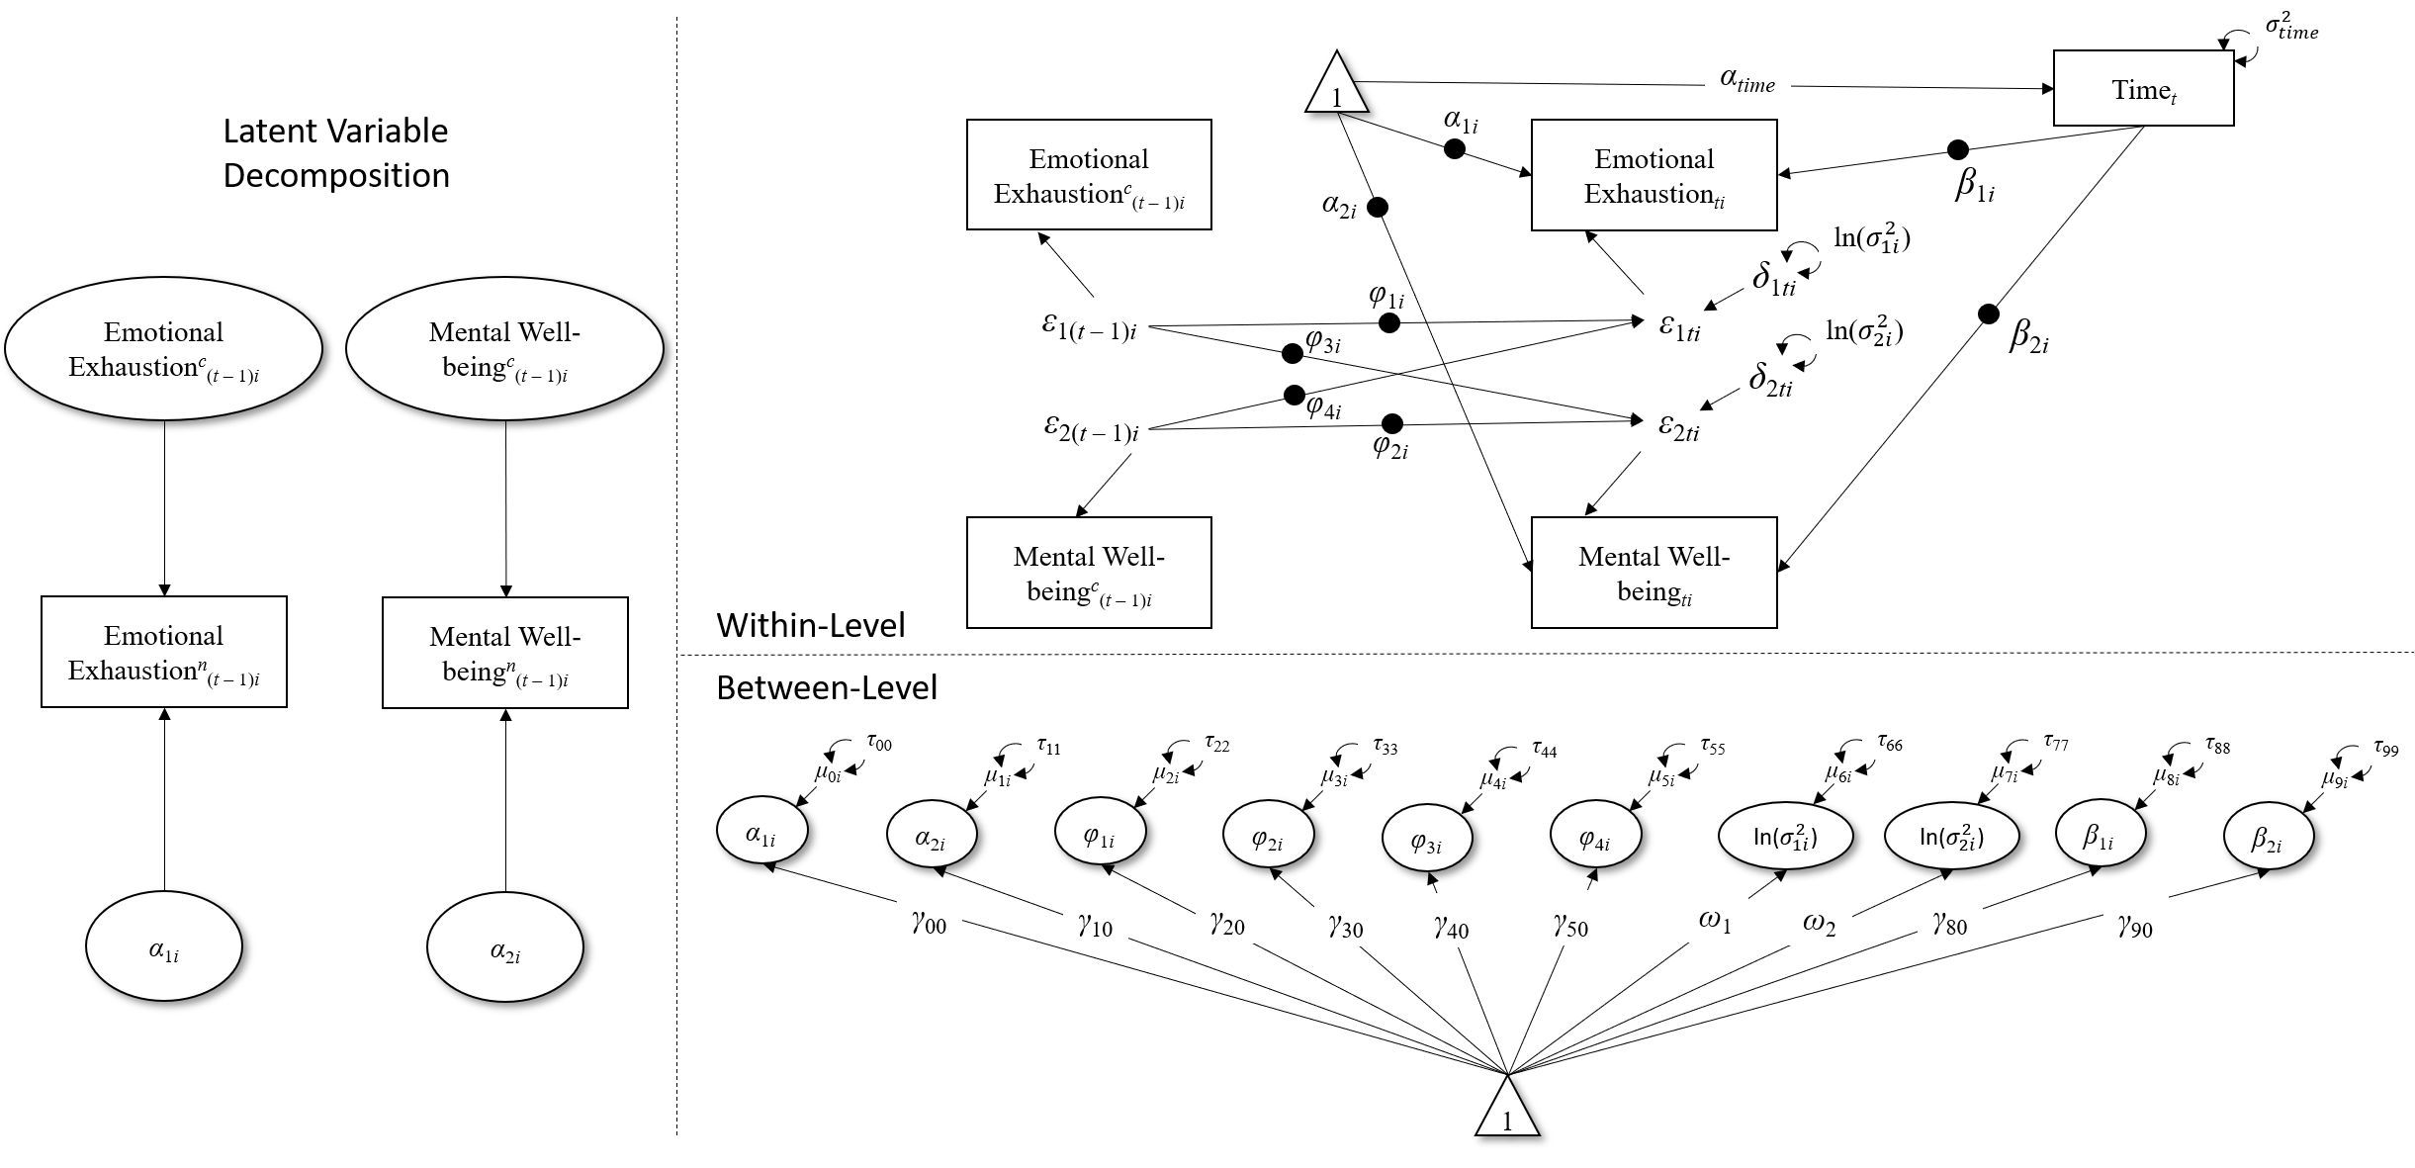
Intro to
SEM
Enrico Perinelli
Dynamic SEM
(Combination of Time Series Modeling, Multilevel Modeling, and SEM)
From Perinelli, Vignoli, Kröner, Müller, Genrich, & Fraccaroli (2023). Syntaxes available in Suppl Material. See «Suggested Reading» section for literature on DSEM

Slide 83
Intro to
SEM
Enrico Perinelli
Mixture Models (Muthén, Psychometrika, 1989)
c
Latent Class Analysis (LCA; if y is dichotomous)
Latent Profile Anlaysis (LPA; if y is continuous)
y₁
y₂
y₃
y₄
y₅
c
c = latent classes
1
κ₁
κ₂
Growth Mixture Model (GMM)
φ₁₁
φ₁₂
φ₂₂
I
S
1
1
1
1
1
1
2
3
4
Y_{T1}
Y_{T2}
Y_{T3}
Y_{T4}
Y_{T5}

Slide 84

Intro to
SEM
Enrico Perinelli
Advancing General Linear Models
Alessandri, G., Zuffianò, A., & Perinelli, E. (2017). Evaluating intervention programs with a pretest-posttest design: A Structural Equation Modeling approach. Frontiers in Psychology: Quantitative Psychology and Measurement, 8, Article 223. https://doi.org/10.3389/fpsyg.2017.00223

Slide 85
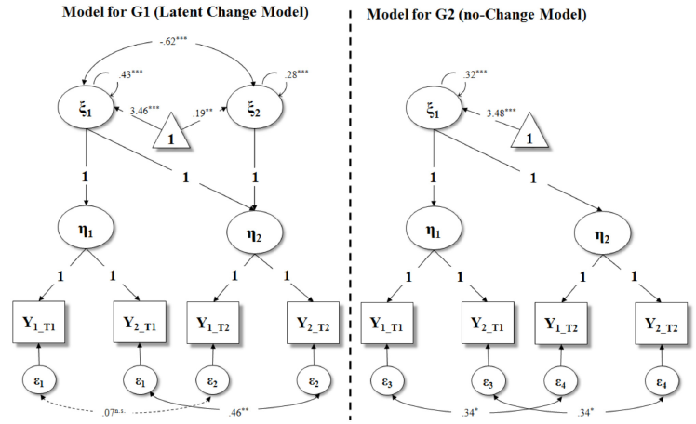
Intro to
SEM
Enrico Perinelli
Advancing General Linear Models
Second-Order Multiple-Group Latent Curve Model
G1 = Intervention group
G2 = Control group
Alessandri, Zuffianò, & Perinelli (2017)

Slide 86
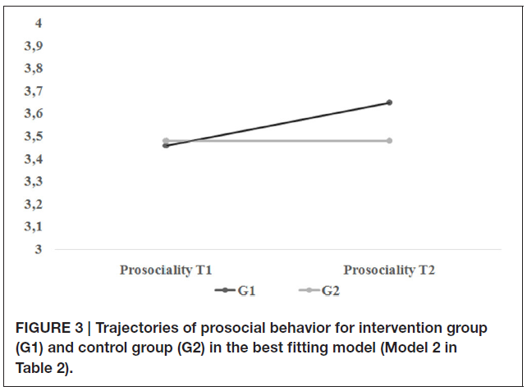
Intro to
SEM
Enrico Perinelli
Advancing Mixed Models
Second-Order Multiple-Group Latent Curve Model
G1 = Intervention group
G2 = Control group
Alessandri, Zuffianò, & Perinelli (2017)

Slide 87
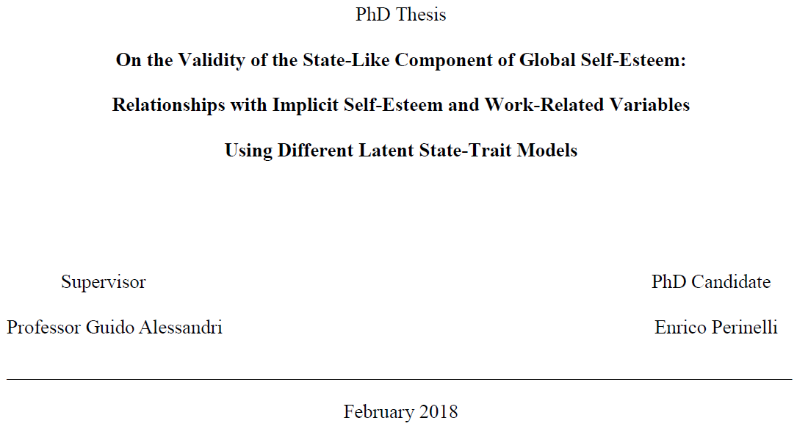
Intro to
SEM
Enrico Perinelli
Other Types
Latent Transition Analysis
Latent Change (Difference) Score
Latent State-Trait (LST) Models
.
.
.
.
.
and much else….

Slide 88
Intro to
SEM
Enrico Perinelli
Introduction to Mplus

Slide 89

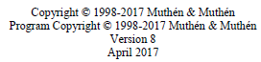

Intro to
SEM
Enrico Perinelli
Mplus
Mplus is currently one of the most used software for latent variables analyses.

Slide 90
Intro to
SEM
Enrico Perinelli
Mplus
Its popularity is mainly due to:
a user-friendly syntax
Syntax | Action
ON | Regressed on (defines structural paths)
BY | Measured by (defines factor loadings)
WITH | Covaried with
IND | Indirect effect
[] | Mean structure and intercept
() | Assigns a label
@ | Fixes a parameter to a specific value
* | Parameter freed/Specifies a starting value for a parameter
MODEL INDIRECT | Specifies the indirect effect to be computed
MODEL CONSTRAINT | Specifies linear and nonlinear constraints

Slide 91
Intro to
SEM
Enrico Perinelli
Mplus
Its popularity is mainly due to:
The availability of a web-site (https://www.statmodel.com/) that provides:
information on the use of the software through a full-detailed user’s guide (https://www.statmodel.com/download/usersguide/MplusUserGuideVer_8.pdf)
A forum in which users can deal (by questioning, by answering or simply by reading) with a broad variety of topics (https://www.statmodel.com/cgi-bin/discus/discus.cgi)
A pletora of real data examples (https://www.statmodel.com/ugexcerpts.shtml)
Videos and Handouts for Short Courses (https://www.statmodel.com/course_materials.shtml)

Slide 92
Intro to
SEM
Enrico Perinelli
Mplus
Its popularity is mainly due to:
The availability of several estimators.
Syntax | Estimator
ML | Maximum Likelihood
MLM | Satorra-Bentler chi-square
MLMV | ML with mean- and variance-adjusted
MLR | Yuan-Bentler chi-square
MLF | ML with standard errors approximated by first-order derivatives
MUML | Muthén’s limited information parameter estimates
WLS | Weighted least square
WLSM | Weighted least square mean-adjusted
WLSMV | Weighted least square mean- and variance-adjusted
ULS | Unweighted least squares
ULSMV | ULS mean- and variance-adjusted
GLS | Generalized Least Square
BAYES | Bayesian posterior parameter estimates with credibility intervals and posterior predictive checking

Slide 93
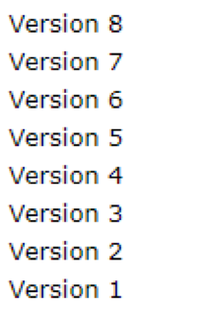
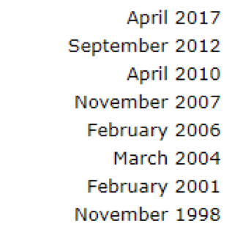
Intro to
SEM
Enrico Perinelli
Mplus
Its popularity is mainly due to:
Constantly updated software
Current version (Feb 2023): 8.8

Slide 94
Intro to
SEM
Enrico Perinelli
Mplus
Its popularity is mainly due to:
The availability of several books
Byrne, B. M. (2013). Structural equation modeling with Mplus: Basic concepts, applications, and programming. New York and London: Routledge.
Geiser, C. (2013). Data analysis with Mplus. New York: Guilford Press.
Grimm, K. J., Ram, N., & Estabrook, R. (2017). Growth Modeling: Structural equation and multilevel modeling approaches. New York: Guilford Press.
Heck, R. H., & Thomas, S. L. (2015). An introduction to multilevel modeling techniques: MLM and SEM approaches using Mplus. New York and London: Routledge.
Muthén, B., Muthén, L. K., Asparouhov , T. (2016). Regression and mediation analysis using Mplus. Los Angeles, CA: Muthén & Muthén.
Wang, J., & Wang, X. (2012). Structural equation modeling: Applications using Mplus. Chichester, UK: John Wiley & Sons.
Wickrama, K. A. S., Lee, T. K., O’Neal, C. W., & Lorenz, F. O. (2016). Higher order growth curves and mixture modeling with Mplus: A practical guide. New York, NY: Routledge.

Slide 95
Intro to
SEM
Enrico Perinelli
Mplus
Important steps for preparing dataset to be used in Mplus:
Coding missing values (I suggest -99 if you work in SPSS; for R, see the subsequent slide)
Create an ASCII data file and eventually convert commas with dots (in Notepad; for R this is not necessary)
Commands and Basic analysis (in Mplus)
Output for Basic analysis (in Mplus)

Slide 96
Intro to
SEM
Enrico Perinelli
Mplus
Important steps for preparing dataset to be used in Mplus:
In order to create a dataset for Mplus, for R use the subsequent syntax
# Initial setup -----------------------------------------------------------
rm(list = ls())
setwd("C:/Users/Enrico Perinelli/Desktop") # set your working directory or use a .Rproj file)
# Load or exctract dataset ------------------------------------------------
library(psych)
my_bfi <- bfi
# Load `MplusAutomation` package ------------------------------------------
library(MplusAutomation)
# Use the `prepareMplusData` function -------------------------------------
prepareMplusData(
my_bfi,
filename = "bfi.dat"
)

Slide 97
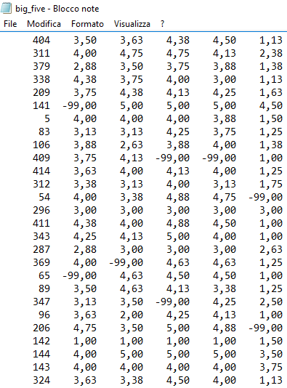
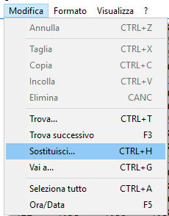
Intro to
SEM
Enrico Perinelli
Mplus
For SPSS, instead, you must be sure that commas are replaced with dots (1)

Slide 98
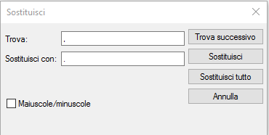
Intro to
SEM
Enrico Perinelli
Mplus
For SPSS, instead, you must be sure that commas are replaced with dots (2)
, (comma)
. (dot)

Slide 99
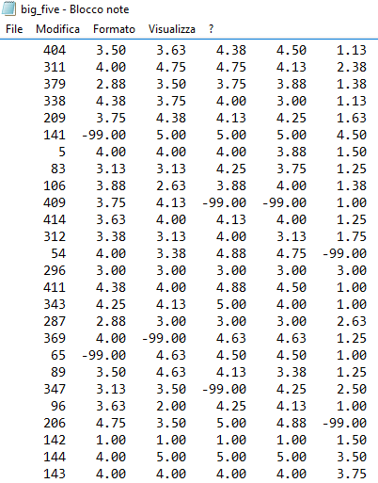
Intro to
SEM
Enrico Perinelli
Mplus
For SPSS, instead, you must be sure that commas are replaced with dots (3)
NOW, ALL THE COMMAS ARE DOTS

Slide 100
Intro to
SEM
Enrico Perinelli
Mplus
Syntax | Function
TITLE | Provide a title for the analysis
DATA | Provide information about the data set to be analyzed
VARIABLE | Provide information about the variables in the data set
DEFINE | Transform existing variables and create new variables
ANALYSIS | Describe the technical details of the analysis (e.g., Estimator, type)
MODEL | Describe the model to be estimated
OUTPUT | Request additional output not included as the default
SAVEDATA | Save the analysis data (e.g., Auxiliary data)
PLOT | Request graphical displays of analysis results
MONTECARLO | Specify the details of a monte carlo simulation study
! | This symbol is used to take notes
; | This symbol must be placed at the end of each command line

Slide 101
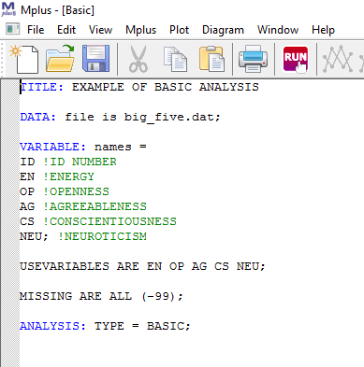
Intro to
SEM
Enrico Perinelli
Mplus
CLICK RUN
Remember that
variable names cannot
be longer than
8 characters

Slide 102
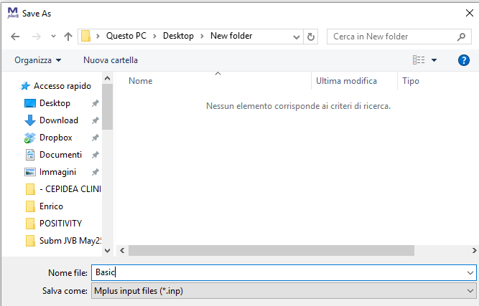
Intro to
SEM
Enrico Perinelli
Mplus
Save the input file in the same folder of the .dat file

Slide 103
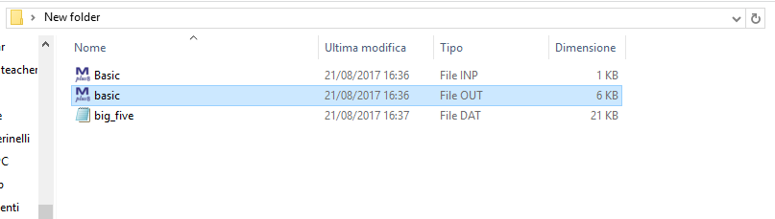
Intro to
SEM
Enrico Perinelli
Mplus

Slide 104
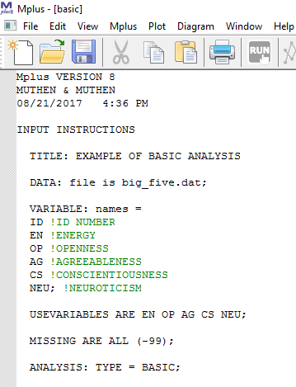
Intro to
SEM
Enrico Perinelli
Mplus
Mplus version
and date
Input instruction

Slide 105
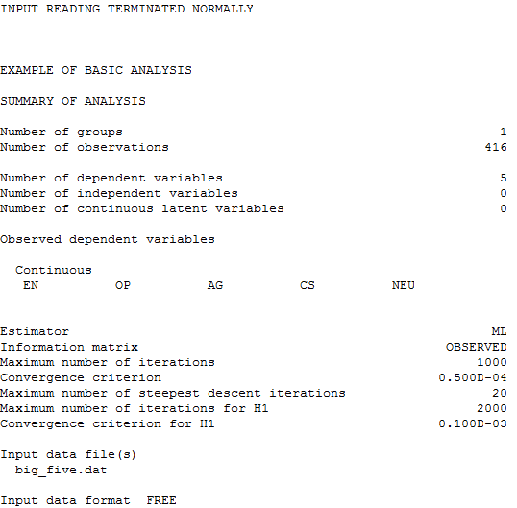
Intro to
SEM
Enrico Perinelli
Mplus
The analysis has gone well!!
Title and information on the number of variables. Here we have only continuous
variables, but this part of the output may displays also the number of latent variables
By default in most of analyses the estimator is ML (in Multilevel modeling the default estimator is MLR)

Slide 106
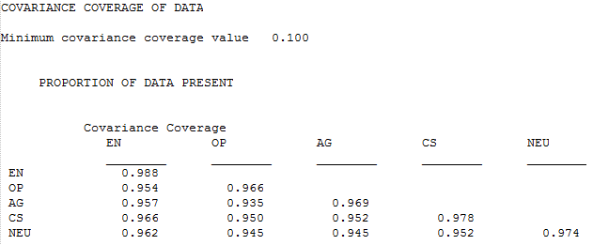
Intro to
SEM
Enrico Perinelli
Mplus
This matrix shows the percentage of covariance coverage for each pair of observed variables. When dataset does not have missing data, each pair of observed variables has a covariance coverage of 100%.

Slide 107
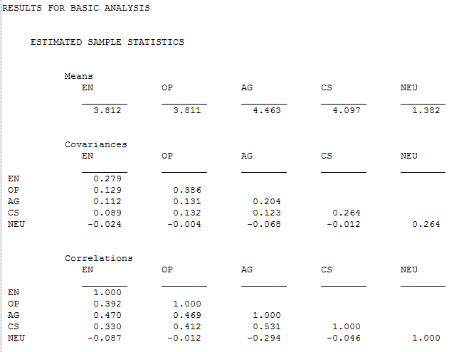
Intro to
SEM
Enrico Perinelli
Mplus
Here, information concerning Means, Covariances and Correlations are reported.

Slide 108

Intro to
SEM
Enrico Perinelli
Mplus
Here, information concerning univariate sample statistics are reported.
A VERY IMPORTANT STEP IS TO CHECK THE TRUSTWORTHINESS OF THESE VALUES!!!!
WHEN THE DATASET IS LARGE, IT IS EASY TO WRONG SPECIFY VARIABLE NAMES, OR FORGET TO SPECIFY THE MASSING DATA VALUE.

Slide 109

Intro to
SEM
Enrico Perinelli
Mplus User’s guide
Intro
Specific Models
(types of SEM)
Information regarding
commands and
syntaxes
Link:
https://www.statmodel.com/download/usersguide/MplusUserGuideVer_8.pdf

Slide 110

Intro to
SEM
Enrico Perinelli
Mplus CFA example
(Geiser, 2013, p. 53)

Slide 111
Intro to
SEM
Enrico Perinelli
Mplus CFA example
(Geiser, 2013, p. 53)
title: CFA for the six KFT variables
3-Factor model (see Figure 3.8)
data: file = KFT.dat;
listwise = on;
variable: names = kft_v1 kft_v3 kft_q1 kft_q3 kft_n1 kft_n3;
missing = all(-99);
analysis: type = general;
model: KFT_V by kft_v1 kft_v3; ! verbal ability factor
KFT_Q by kft_q1 kft_q3; ! numeric ability factor
KFT_N by kft_n1 kft_n3; ! figural (non-verbal) ability factor
output: sampstat stdyx tech4;

Slide 112

Intro to
SEM
Enrico Perinelli
Mplus Second-Order CFA example
(Geiser, 2013, p. 59)

Slide 113
Intro to
SEM
Enrico Perinelli
Mplus Second-Order CFA example
(Geiser, 2013, p. 59)
title: CFA for the six KFT variables
Second-order factor model (see Figure 3.11)
data: file = KFT.dat;
listwise = on;
variable: names = kft_v1 kft_v3 kft_q1 kft_q3 kft_n1 kft_n3;
missing = all(-99);
analysis: type = general;
model: ! First-order factors
KFT_V by kft_v1 kft_v3; ! verbal ability factor
KFT_Q by kft_q1 kft_q3; ! numeric ability factor
KFT_N by kft_n1 kft_n3; ! figural (non-verbal) ability factor
! Second-order factor
KFT_G by KFT_V KFT_Q KFT_N;
output: sampstat stdyx;

Slide 114

Intro to
SEM
Enrico Perinelli
Mplus SEM example
(Geiser, 2013, p. 74)
ζ₃

Slide 115
Intro to
SEM
Enrico Perinelli
Mplus SEM example
(Geiser, 2013, p. 74)
title: Latent path model shown in Figure 3.15
Relationship between physical health, functional health, and subjective health
data: file = health.dat;
variable: names = SHP ! Subjektive health in the present
SHC ! Changes in subjective health across the past 6 years
SICK ! Number of health issues in the past 12 months
CONSULT ! Number of physician consultations in the past 12 months
FH ! Total score SF-36 scale on functional health
FH1 FH2; ! SF-36 scale split into 2 test halves/item parcels
usevar = SHP SHC SICK CONSULT FH1 FH2;
analysis: type = general;
model: SH by SHP SHC; ! Factor/Measurement model subjective health
PH by SICK CONSULT; ! Factor/Measurement model physical health
FH by FH1 FH2; ! Factor/Measurement model functional health
! Path analysis at the level of the latent variables
FH on PH;
SH on PH FH;
model indirect: SH ind PH; ! Request output of direct, indirect, and total effects
output: sampstat stdyx;

Slide 116
Intro to
SEM
Enrico Perinelli
Mplus SEM example (bootstrap)
(Geiser, 2013, p. 74)
title: Latent path model shown in Figure 3.15
Relationship between physical health, functional health, and subjective health
With bias-corrected bootstrap confidence intervals
data: file = health.dat;
variable: names = SHP ! Subjektive health in the present
SHC ! Changes in subjective health across the past 6 years
SICK ! Number of health issues in the past 12 months
CONSULT ! Number of physician consultations in the past 12 months
FH ! Total score SF-36 scale on functional health
FH1 FH2; ! SF-36 scale split into 2 test halves/item parcels
usevar = SHP SHC SICK CONSULT FH1 FH2;
analysis: type = general;
bootstrap = 10000; ! Request 10000 bootstrap samples
model: SH by SHP SHC; ! Factor/Measurement model subjective health
PH by SICK CONSULT; ! Factor/Measurement model physical health
FH by FH1 FH2; ! Factor/Measurement model functional health
! Path analysis at the level of the latent variables
FH on PH;
SH on PH FH;
model indirect: SH ind PH; ! Request output of direct, indirect, and total effects
output: sampstat stdyx
cinterval(bcbootstrap); ! Request confidence intervals based on bias-corrected bootstrap

Slide 117
Intro to
SEM
Enrico Perinelli
Suggested Reading
Suggested ‘Starters’ for SEM
Kline, R. B. (2016). Principles and practice of structural equation modeling (4th ed.). The Guilford Press.
Hoyle, R. K. (2023). Handbook of Structural Equation Modeling (2nd ed.). The Guilford Press.
Hancock, G. R., & Mueller, R. O. (2013). Structural Equation Modeling: A second course. IAP.
Old but gold - Still the best book on SEM mathematical bases
Bollen, K. A. (1989). Structural equations with latent variables. Wiley.
Longitudinal SEM
Bollen, K. A., & Curran, P. J. (2006). Latent curve models: A structural equation perspective. Wiley.
Little, T. D. (2013). Longitudinal structural equation modeling. The Guilford Press.
McArdle, J. J., & Nesselroade, J. R. (2014). Longitudinal data analysis using structural equation models. American Psychological Association. doi: 10.1037/14440-000
Newsom, J. T. (2015). Longitudinal structural equation modeling: A comprehensive introduction. Routledge.
Grimm, K. J., Ram, N., & Estabrook, R. (2017). Growth Modeling: Structural equation and multilevel modeling approaches. The Guilford Press.
Ferrer, E., Boker, S. M., & Grimm, K. J. (2019). Longitudinal multivariate psychology. Routledge.

Slide 118
Intro to
SEM
Enrico Perinelli
Suggested Reading
CFA
Brown, T. A. (2015). Confirmatory Factor Analysis for applied research (2nd ed.). The Guilford Press.
Mixture
Nylund, K. L., Asparouhov, T., & Muthén, B. O. (2007). Deciding on the number of classes in latent class analysis and growth mixture modeling: A Monte Carlo simulation study. Structural Equation Modeling: A Multidisciplinary Journal, 14, 535-569. doi:10.1080/10705510701575396
Nylund-Gibson, K., & Choi, A. Y. (2018). Ten frequently asked questions about latent class analysis. Translational Issues in Psychological Science, 4(4), 440–461. https://doi.org/10.1037/tps0000176
Jung, T., & Wickrama, K. A. S. (2008). An introduction to latent class growth analysis and growth mixture modeling. Social and Personality Psychology Compass, 2, 302-317. doi:10.1111/j.1751-9004.2007.00054.x
Collins, L. M., & Lanza, S. T. (2010). Latent class and latent transition analysis: With applications in the social, behavioral, and health sciences. John Wiley & Sons, Inc.
van De Schoot, R., Sijbrandij, M., Winter, S. D., Depaoli, S., & Vermunt, J. K. (2017). The GRoLTS-Checklist: Guidelines for Reporting on Latent Trajectory Studies. Structural Equation Modeling: A Multidisciplinary Journal, 24, 451-467. doi: 10.1080/10705511.2016.1247646

Slide 119
Intro to
SEM
Enrico Perinelli
Suggested Reading
Dynamic Structural Equation Modeling (DSEM)
Asparouhov, T., Hamaker, E. L., & Muthén, B. (2018). Dynamic Structural Equation Models. Structural Equation Modeling: A Multidisciplinary Journal, 25(3), 359–388. https://doi.org/10.1080/10705511.2017.1406803
Asparouhov, T., & Muthén, B. (2020). Comparison of models for the analysis of intensive longitudinal data. Structural Equation Modeling: A Multidisciplinary Journal, 27(2), 275–297. https://doi.org/10.1080/10705511.2019.1626733
Hamaker, E. L., Asparouhov, T., Brose, A., Schmiedek, F., & Muthén, B. (2018). At the frontiers of modeling intensive longitudinal data: Dynamic Structural equation models for the affective measurements from the COGITO study. Multivariate Behavioral Research, 53(6), 820–841. https://doi.org/10.1080/00273171.2018.1446819
Hamaker, E. L., Asparouhov, T., & Muthén, B. (2023). Dynamic structural equation modeling as a combination of time series modeling, multilevel modeling, and structural equation modeling. In R. H. Hoyle (Ed.), Handbook of structural equation modeling (2nd ed., pp. 576-596). The Guilford Press.
McNeish, D., & Hamaker, E. L. (2020). A primer on two-level dynamic structural equation models for intensive longitudinal data in Mplus. Psychological Methods, 25(5), 610–635. https://doi.org/10.1037/met0000250
Wang, J., & Wang, X. (2020). Structural Equation Modeling: Applications Using Mplus (2nd ed.). John Wiley & Sons. [Section 4.8, pp. 241-252]

Slide 120
Intro to
SEM
Enrico Perinelli
Suggested Reading
Maximum Likelihood
Enders, C. K. (2022). Applied missing data analysis (Chapter 2). The Guilford Press.
Myung, I. J. (2003). Tutorial on maximum likelihood estimation. Journal of Mathematical Psychology, 47, 90-100. doi: 10.1016/S0022-2496(02)00028-7
Stigler, S. M. (2007). The epic story of maximum likelihood. Statistical Science, 22(4), 598-620.
Mplus
Geiser, C. (2013). Data analysis with Mplus. The Guilford Press.
Geiser, C. (2021). Longitudinal structural equation modeling with Mplus: A Latent State-Trait perspective. The Guilford Press.
Byrne, B. M. (2013). Structural equation modeling with Mplus: Basic concepts, applications, and programming. Routledge.
Wang, J., & Wang, X. (2020). Structural equation modeling: Applications using Mplus (2nd ed.). John Wiley & Sons.
Wickrama, K. A. S., Lee, T. K., O’Neal, C. W., & Lorenz, F. O. (2016). Higher order growth curves and mixture modeling with Mplus: A practical guide. Routledge.
Heck, R. H., & Thomas, S. L. (2015). An introduction to multilevel modeling techniques: MLM and SEM approaches using Mplus (3rd ed.). Routledge.
Muthén, B., Muthén, L. K., Asparouhov , T. (2016). Regression and mediation analysis using Mplus. Muthén & Muthén.

Slide 121
Intro to
SEM
Enrico Perinelli
Suggested Reading
lavaan (R package)
https://lavaan.ugent.be/tutorial/
https://lavaan.ugent.be/tutorial/tutorial.pdf
https://stats.oarc.ucla.edu/r/seminars/rsem/
https://users.ugent.be/~yrosseel/lavaan/gent2020/lavaan_twodays_gent2020.pdf
Geiser, C. (2023). Structural equation modeling with the Mplus and lavaan programs. In R. Hoyle (Ed.), Handbook of structural equation modeling (2nd ed., pp. 241-258). Guilford Press.
SEM in Python with semopy package
https://pypi.org/project/semopy/ and https://semopy.com/
Igolkina, A. A., & Meshcheryakov, G. (2020). Semopy: A Python package for structural equation modeling. Structural Equation Modeling: A Multidisciplinary Journal, 27(6), 952-963.
Bayesian SEM (BSEM)
Books and Chapters
Depaoli, S. (2021). Bayesian Structural Equation Modeling. The Guilford Press.
Kaplan, D. (2014). Bayesian statistics for the social sciences. The Guilford Press.
Kaplan, D., & Depaoli, S. (2012). Bayesian Structural Equation Modeling. In R. H. Hoyle (Ed.), Handbook of Structural Equation Modeling (pp. 650-673). The Guilford Press.
Lee, S. Y., & Song, X. Y. (2012). Basic and advanced Bayesian structural equation modeling: With applications in the medical and behavioral sciences. John Wiley & Sons.

Slide 122
Intro to
SEM
Enrico Perinelli
Suggested Reading
Bayesian SEM (BSEM)
Articles:
Lee, S. Y. (1981). A Bayesian approach to confirmatory factor analysis. Psychometrika, 46(2), 153-160. [First BSEM ever]
Depaoli, S., & van de Schoot, R. (2017). Improving transparency and replication in Bayesian statistics: The WAMBS-Checklist. Psychological Methods, 22(2), 240–261.
McNeish, D. (2016) On using bayesian methods to address small sample problems. Structural Equation Modeling: A Multidisciplinary Journal, 23(5), 750-773.
Muthén, B., & Asparouhov, T. (2012). Bayesian structural equation modeling: A more flexible representation of substantive theory. Psychological Methods, 17(3), 313–335.
Smid, S. C., McNeish, D., Miočević, M., & van de Schoot, R. (2020). Bayesian versus frequentist estimation for Structural Equation Models in small sample contexts: A systematic review. Structural Equation Modeling: A Multidisciplinary Journal, 27(1), 131-161.
van de Schoot, R., Kaplan, D., Denissen, J., Asendorpf, J. B., Neyer, F. J., & Van Aken, M. A. (2014). A gentle introduction to Bayesian analysis: Applications to developmental research. Child Development, 85(3), 842-860.
Zondervan-Zwijnenburg, M., Peeters, M., Depaoli, S., & van de Schoot, R. (2017). Where do priors come from? Applying guidelines to construct informative priors in small sample research. Research in Human Development, 14(4), 305-320.

Slide 123
Intro to
SEM
Enrico Perinelli
Suggested Reading
Machine Learning and Latent Variables/Psychometrics (Part 1)
Bleidorn, W., & Hopwood, C. J. (2019). Using machine learning to advance personality assessment and theory. Personality and Social Psychology Review, 23(2), 190-203. https://doi.org/10.1177/1088868318772990
Brandmaier, A. M., & Jacobucci, R. C. (2023). Machine Learning approaches to structural Equation Modeling. In R. H. Hoyle (Ed.), Handbook of structural equation modeling (2nd ed., pp. 722-739). The Guilford Press.
Brandmaier, A. M., von Oertzen, T., McArdle, J. J., & Lindenberger, U. (2013). Structural equation model trees. Psychological Methods, 18(1), 71–86. https://doi.org/10.1037/a0030001
Grimm, K. J., Mazza, G. L., & Davoudzadeh, P. (2017). Model selection in finite mixture models: A k-fold cross-validation approach. Structural Equation Modeling: A Multidisciplinary Journal, 24(2), 246-256. https://doi.org/10.1080/10705511.2016.1250638
Hong, M., Jacobucci, R., & Lubke, G. (2020). Deductive data mining. Psychological Methods, 25(6), 691–707. https://doi.org/10.1037/met0000252
Jacobucci, R., Brandmaier, A. M., & Kievit, R. A. (2019). A practical guide to variable selection in Structural Equation Modeling by using regularized multiple-indicators, multiple-causes models. Advances in Methods and Practices in Psychological Science, 2(1), 55-76. https://doi.org/10.1177/2515245919826527
Jacobucci, R., & Grimm, K. J. (2020). Machine learning and psychological research: The unexplored effect of measurement. Perspectives on Psychological Science, 15(3), 809-816. https://doi.org/10.1177/1745691620902467
Jacobucci, R., Grimm, K. J., & McArdle, J. J. (2016). Regularized structural equation modeling. Structural Equation Modeling: A Multidisciplinary Journal, 23(4), 555-566. https://doi.org/10.1080/10705511.2016.1154793
Jacobucci, R., Grimm, K. J., & Zhang, Z. (2023). Machine learning for social and behavioral research. Guilford.
Landers, R. N. (n.d.). Data science for social scientists. https://datascience.tntlab.org/

Slide 124
Intro to
SEM
Enrico Perinelli
Suggested Reading
Machine Learning and Latent Variables/Psychometrics (Part 2)
Liang, X., & Jacobucci, R. (2020). Regularized structural equation modeling to detect measurement bias: Evaluation of lasso, adaptive lasso, and elastic net. Structural Equation Modeling: A Multidisciplinary Journal, 27(5), 722-734. https://doi.org/10.1080/10705511.2019.1693273
Liem, C. C. S., Langer, M., Demetriou, A., Hiemstra, A. M. F., Wicaksana, A. S., Born, M. P., & König, C. J. (2018). Psychology meets machine learning: Interdisciplinary perspectives on algorithmic job candidate screening. In H. J. Escalante, S. Escalera, I. Guyon, X. Baró, Y. Güçlütürk, U. Güçlü, & M. van Gerven (Eds.), Explainable and interpretable models in computer vision and machine learning (pp. 197-253). Springer. https://doi.org/10.1007/978-3-319-98131-4_9
McNeish, D. M. (2015). Using lasso for predictor selection and to assuage overfitting: A method long overlooked in behavioral sciences. Multivariate Behavioral Research, 50(5), 471-484. https://doi.org/10.1080/00273171.2015.1036965
Orrù, G., Monaro, M., Conversano, C., Gemignani, A., & Sartori, G. (2020). Machine learning in psychometrics and psychological research. Frontiers in Psychology, 10, Article 2970. https://doi.org/10.3389/fpsyg.2019.02970
Serang, S., Jacobucci, R., Brimhall, K. C., & Grimm, K. J. (2017). Exploratory mediation analysis via regularization. Structural Equation Modeling: A Multidisciplinary Journal, 24(5), 733-744. https://doi.org/10.1080/10705511.2017.1311775
Urban, C. J., & Gates, K. M. (2021). Deep learning: A primer for psychologists. Psychological Methods, 26(6), 743–773. https://doi.org/10.1037/met0000374
Woo, S. E., Tay, L., & Proctor, R. W. (2020). Big data in psychological research. American Psychological Association. https://doi.org/10.1037/0000193-000
Yarkoni, T., & Westfall, J. (2017). Choosing prediction over explanation in psychology: Lessons from machine learning. Perspectives on Psychological Science, 12(6), 1100-1122. https://doi.org/10.1177/1745691617693393

Slide 125

Intro to
SEM
Enrico Perinelli
Suggested Reading
A whole journal devoted to the advancement of SEM (since 1994)

Slide 126

Intro to
SEM
Enrico Perinelli

Slide 127
Intro to
SEM
Enrico Perinelli
Thanks for
your attention
enrico.perinelli@unitn.it

